Slide 1
SC_DAMC2
File created on: 2/1/2024 5:23:35 AM

Slide 2
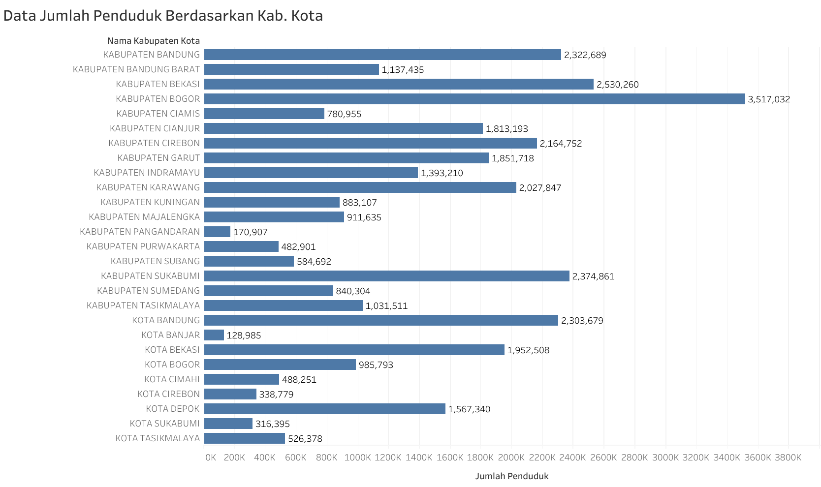

Slide 3
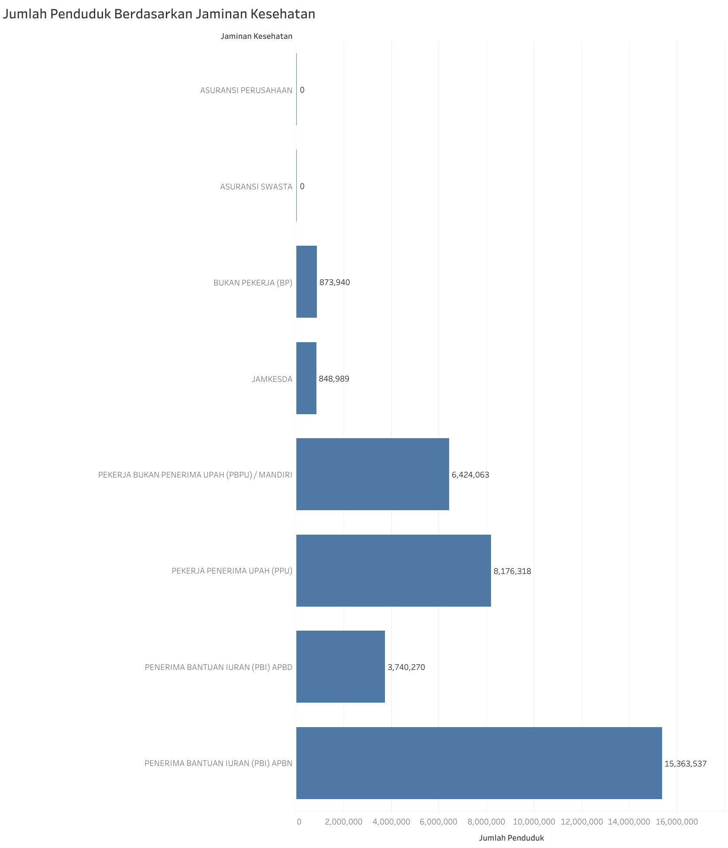

Slide 4
